Slide 1



CMS – 2012
Reduction in Bottom-Up Land Surface CO₂ Flux Uncertainty in NASA’s Carbon Monitoring System Flux Project through Systematic Multi-Model Evaluation and Infrastructure Development
PI: Deborah Huntzinger (NAU)
Co-I: Christopher Schwalm (NAU), Joshua Fisher (JPL),
Junjie Liu (JPL), and Gary Block (JPL)
Graduate student: Jessica Swetish (NAU)
Technical support: Munish Sikka (JPL/NAU)

Slide 2
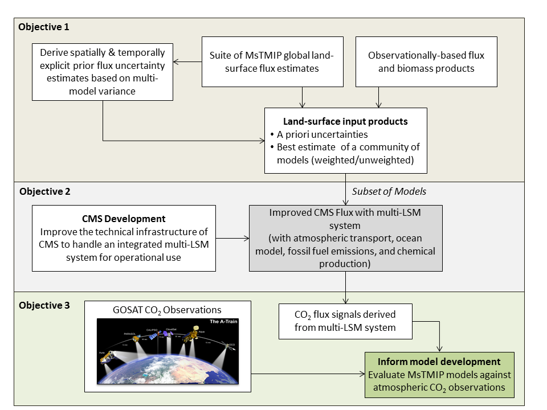
Reducing flux uncertainty in the CMS through a multi-model system

Slide 3
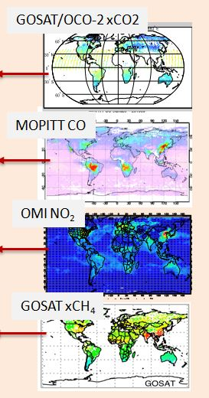
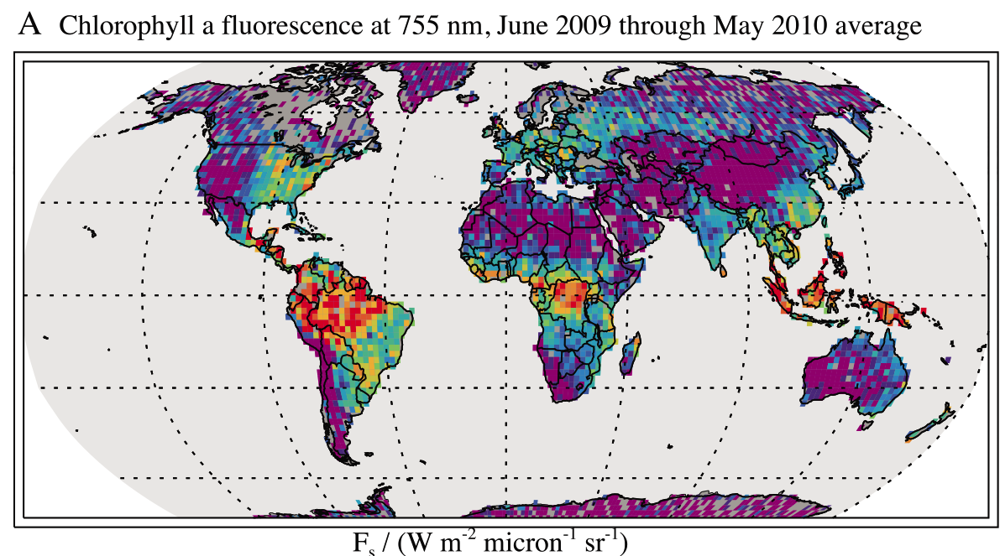
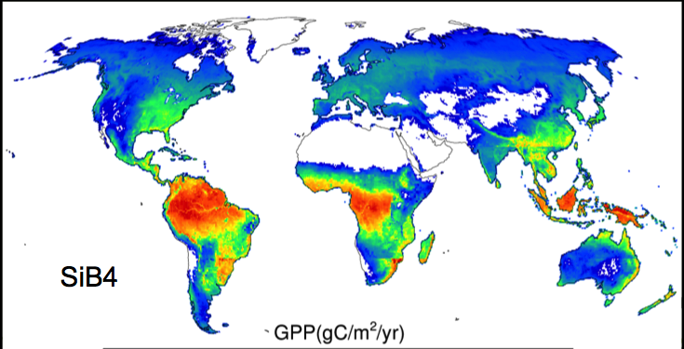
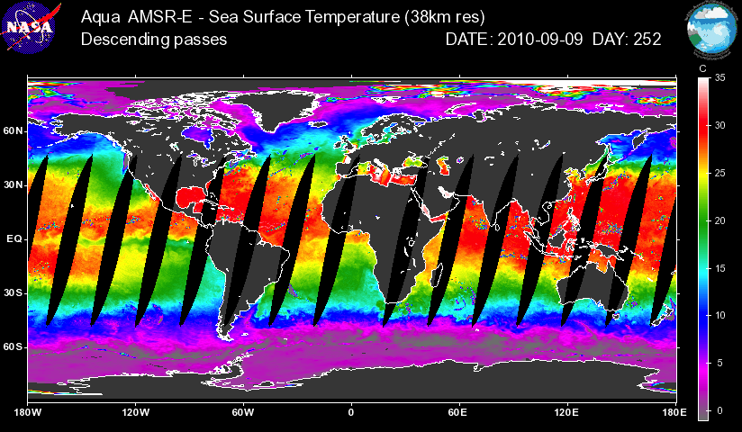
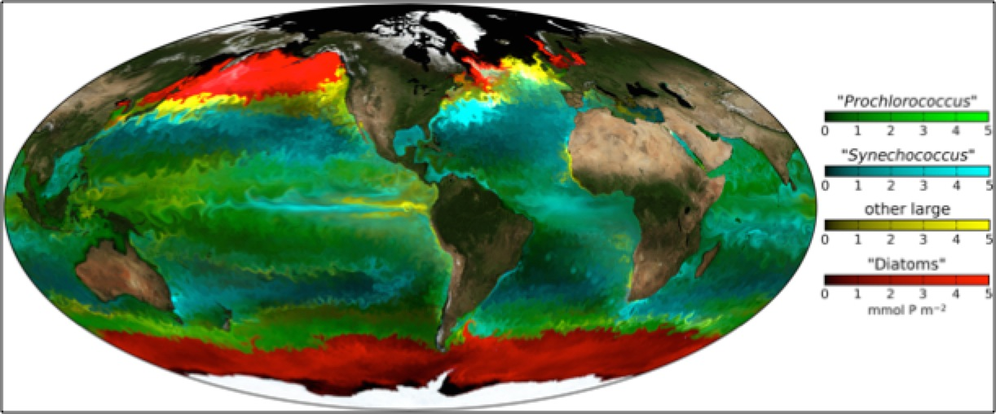
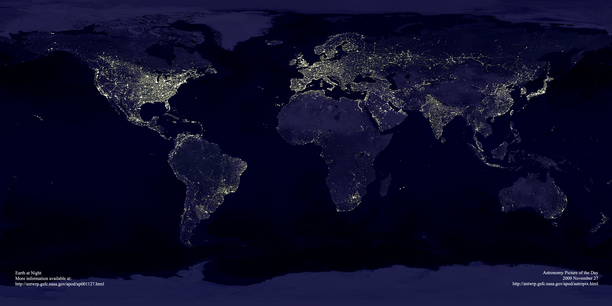
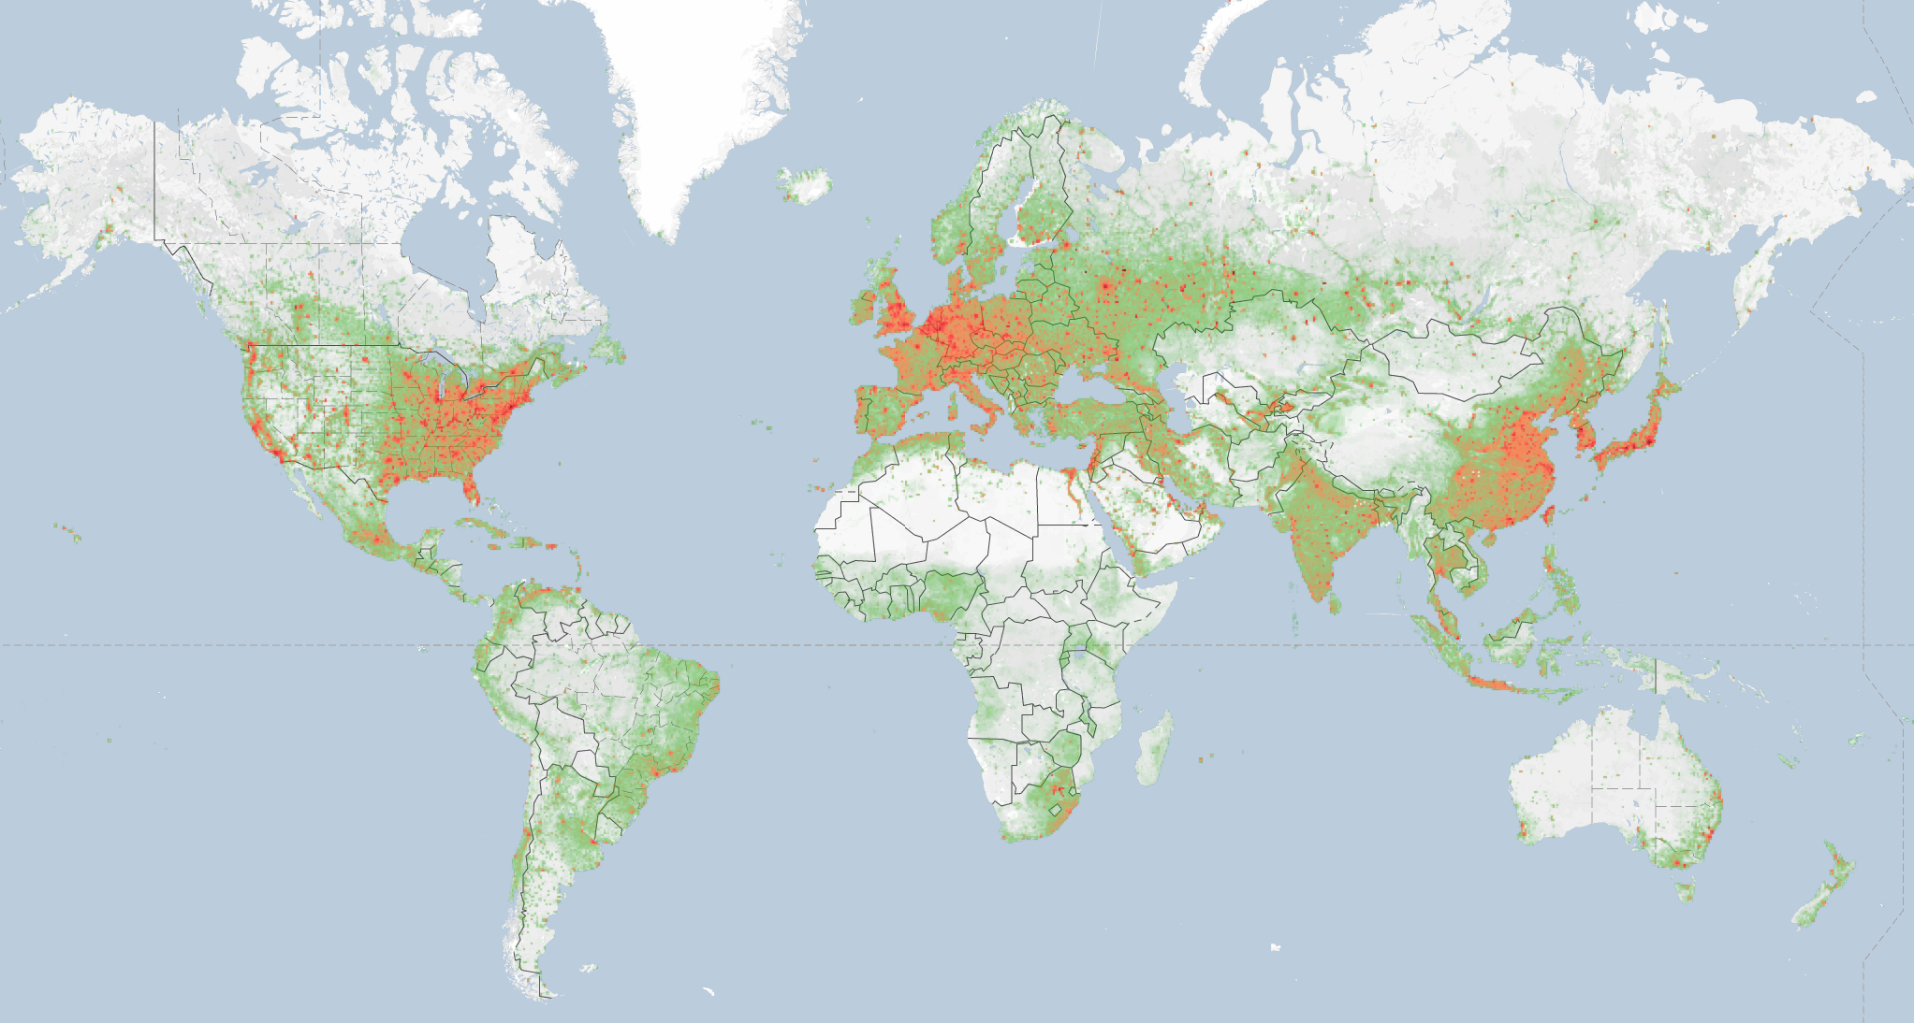
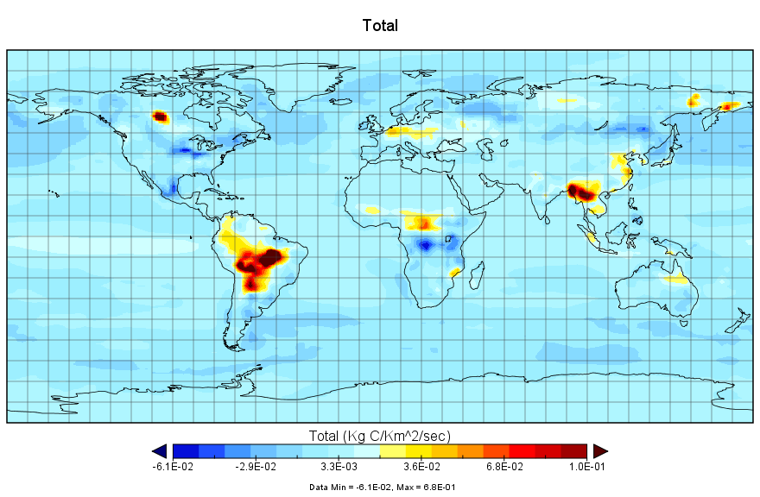
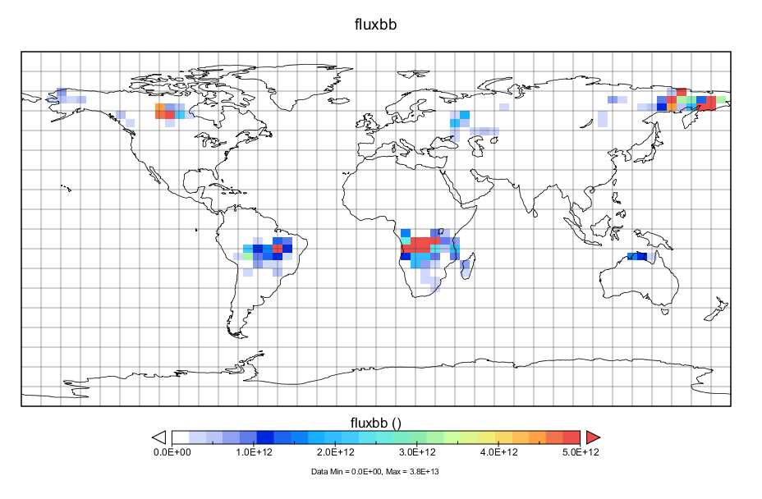
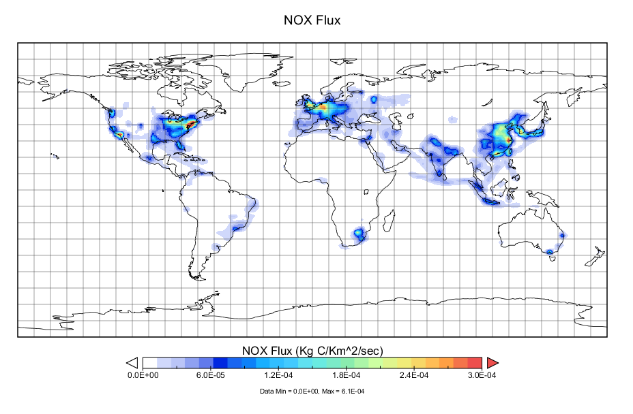
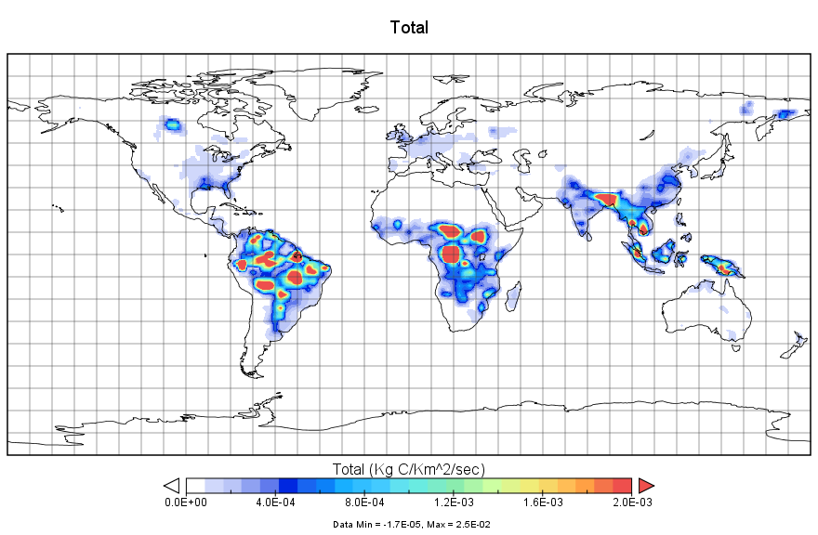
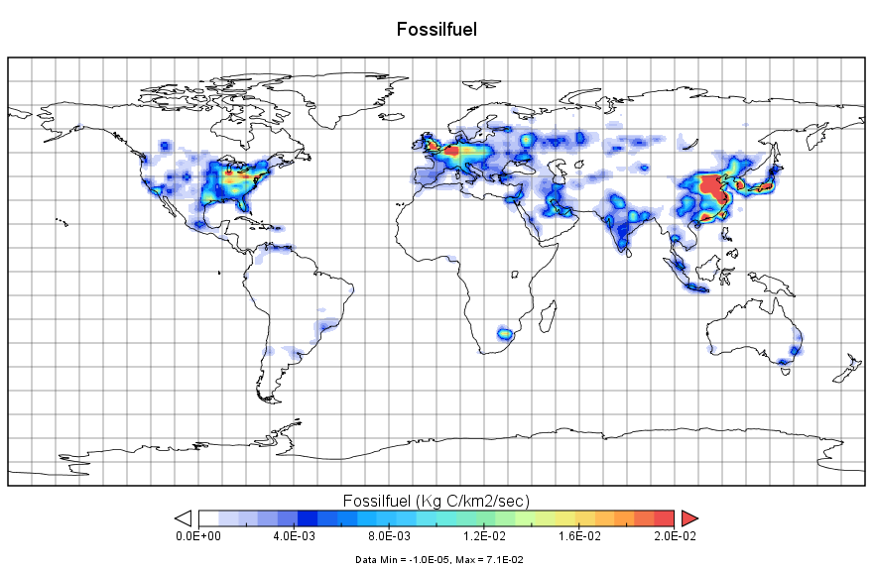
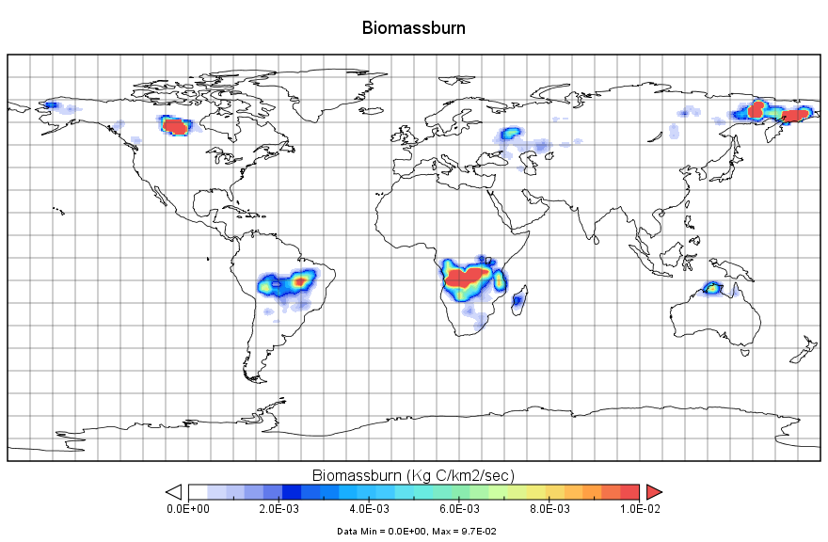
“Bottom-up”
CMS-Flux Framework
“Top-down”
Surface
Satellite Data
Carbon Cycle Models
Chemistry Transport Model
Atmospheric
Satellite Data
Terrestrial
MsTMIP
Ocean
Forecast
Surface fluxes and uncertainties
Observations
Human
Inverse modeling
Reconciliation
Top-down estimates
Total CO₂
NO₂
Total CH₄
CO
Fossil Fuel- NO₂:CO₂
Combustion CO:CH4:CO₂
Posterior fluxes and uncertainties
Attribution
Notes:
GEOS-Chem has a rich history of use in understanding atmospheric composition and the inference of surface fluxes.

Slide 4
Objective 1:
Derive Spatially Explicit Priors (Weighted/Unweighted) And Uncertainties

Slide 5
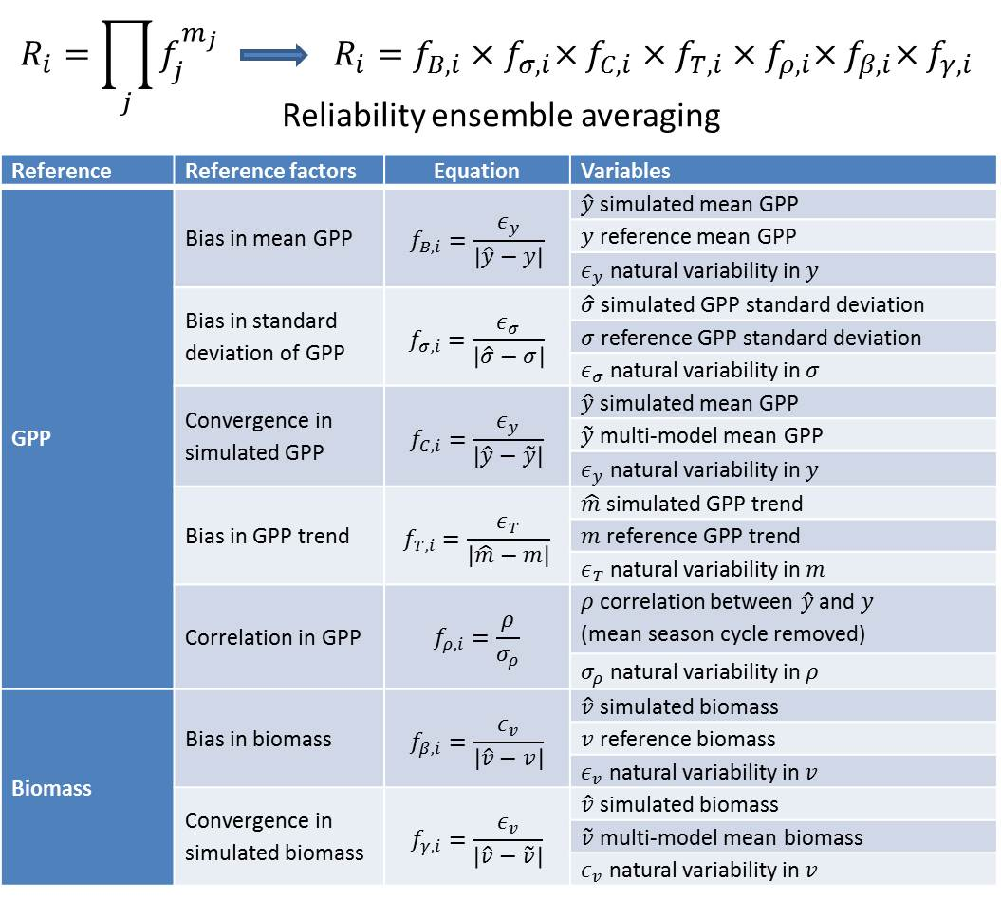
Land surface evaluation
Notes:
R_i ~ (0,1]
Sum to unity across each pixel
Ensemble is 10 models from MsTMIP “best estimate”

Slide 6
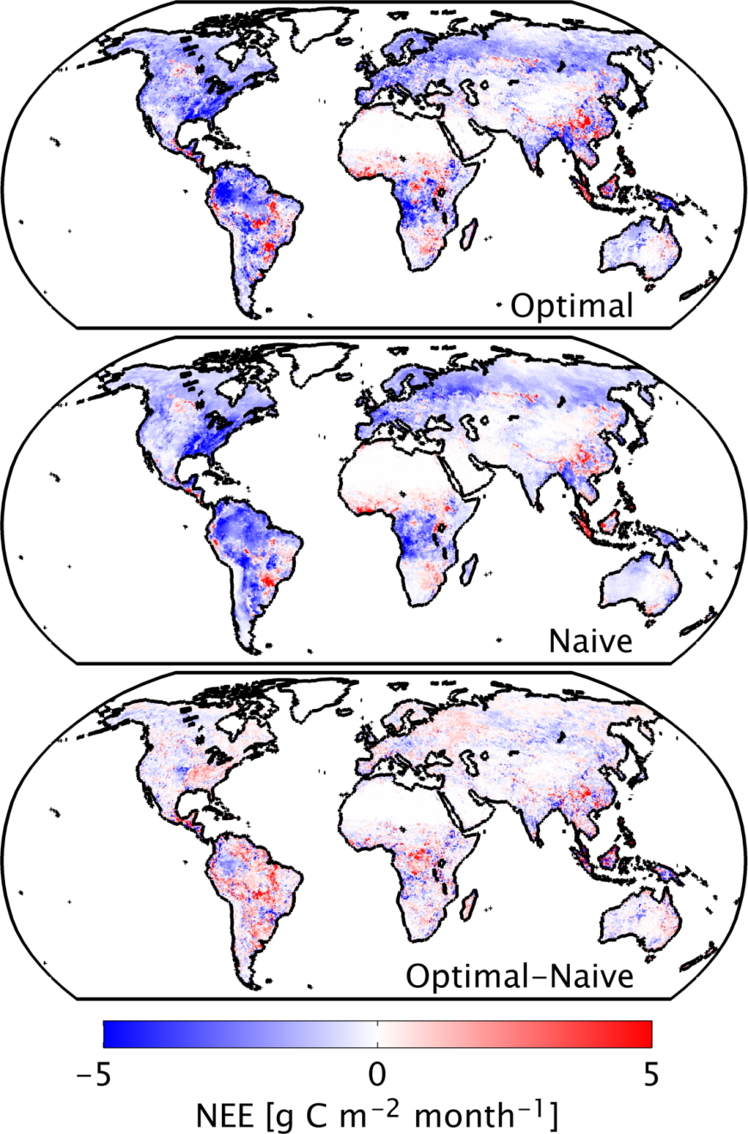
Land surface weighting
Weighted mean
Straight mean
Difference
Schwalm, Huntzinger, Fisher, et al., submitted to GRL.
Notes:
Produced 3 products:
New prior based on straight mean across MsTMIP ensemble
New prior based on weighted mean across MsTMIP ensemble (weights based on previous slide)
Spatially explicit uncertainties on those priors (both weighted and unweighted)

Slide 7
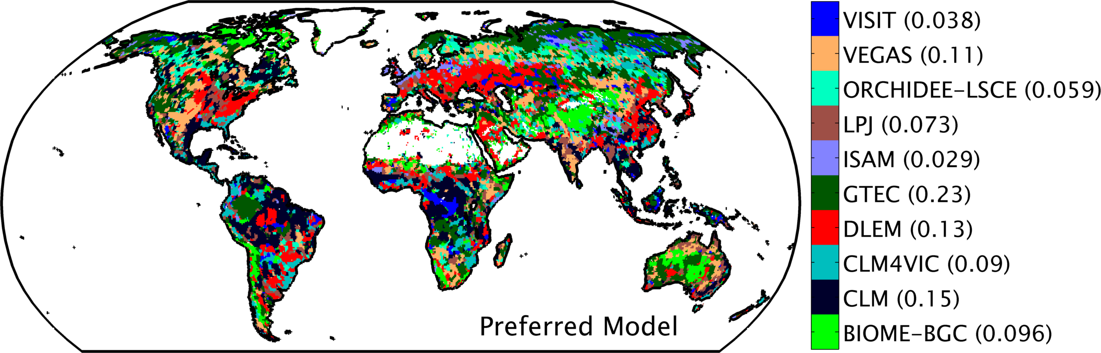
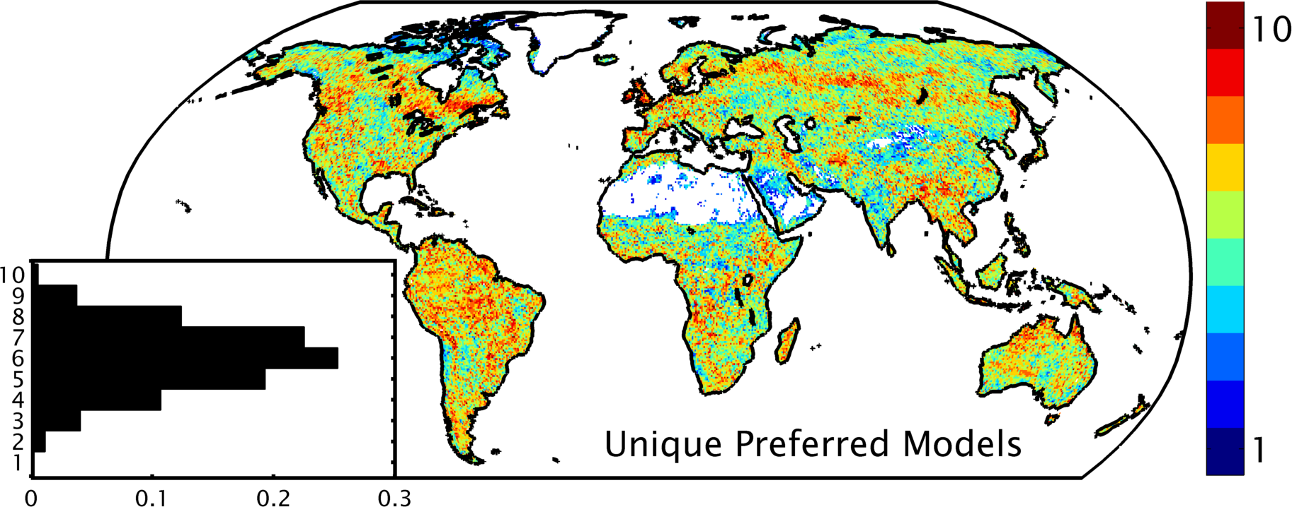
Improved land surface input products
Schwalm, Huntzinger, Fisher, et al., submitted to GRL.
Notes:
Top figure: Based on weighting (evaluation against observationally-based reference products), preferred model by pixel. () is fraction of veg land where model is preferred, only base case
Lower Figure: Inset shows hist of # of preferred models across all bootstrap replicates
Note that optimal vs naïve integration are same -1.15 Pg/yr uptake
Uses MsTMIP Version 1.0 release

Slide 8
Objective 2:
- Develop improved CMS multi-LSM system

Slide 9
Integrate MsTMIP simulation output into GEOS Chem:
Spatial downscaling
Notes:
Monthly model output is downscaled to 3-hourly time steps following Olsen & Randerson 2004

Slide 10
Integrate MsTMIP simulation output into GEOS Chem:
Spatial regridding

Slide 11
Objective 3:
- Evaluate MsTMIP models against CO₂ observations

Slide 12
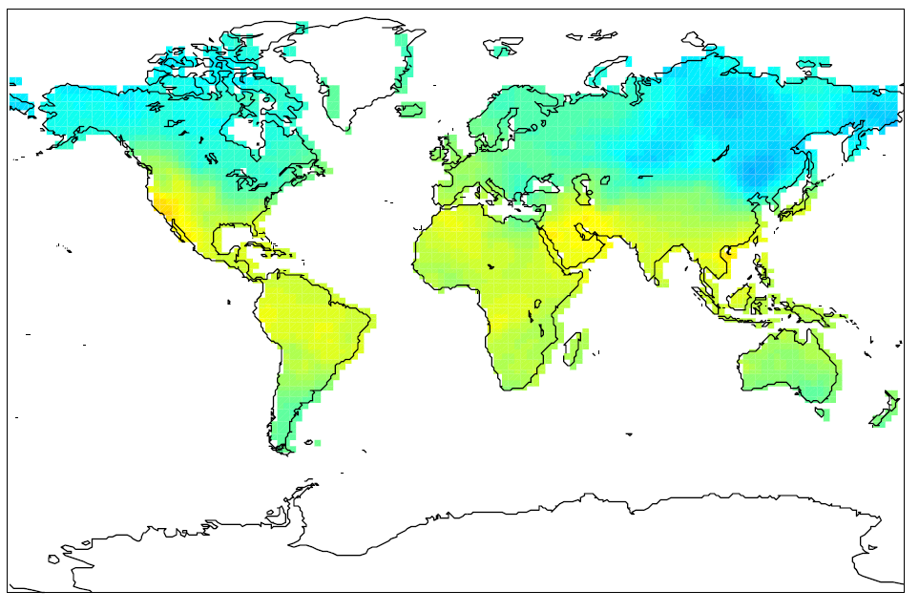
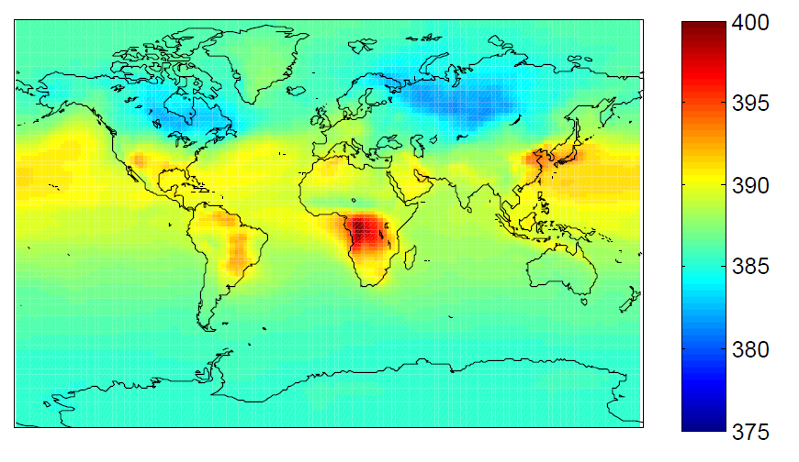

Comparing MsTMIP with CO₂ observations from GOSAT: Forward Model Runs
GOSAT ACOS 3.4 R3 XCO2 Level 3 Map (July 2010)
MsTMIP XCO2 (July 2010)
Data from JPL-ACOS group (lev 3 maps processed by Michalak CO₂ DAAD project)
2 x 2.5 degree resolution
Forward transport of MsTMIP surface fluxes using GEOS-Chem atmospheric transport model (JPL – CMS-flux)
Assessed only at locations where GOSAT lev 3 data is available.
2 x 2.5 degree resolution
*(pre MsTMIP version 1 release)
Notes:
There are a wide range of modeled estimates of NEE.
However, there are no direct estimates of NEE at the spatio-temporal resolution of model estimates (e.g., 0.5° x 0.5° degree and sub-daily to monthly) to assess model skill.
The atmosphere provides and integrated view of surface sources and sinks of carbon and may be a potentially powerful observational constraint for TBMs.
We use observations of atmospheric CO₂ from GOSAT to assess TBMs (via transported surface fluxes).

Slide 13
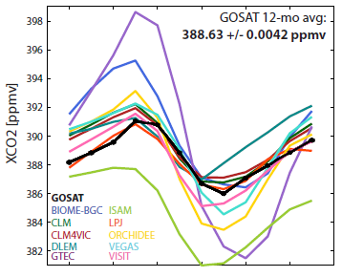
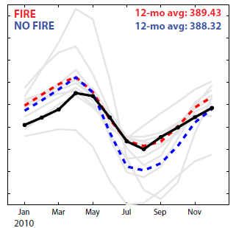
MsTMIP Forward Model Runs vs. GOSAT
Seasonal cycle
—GOSAT
Assess models based on how consistent they are w/ GOSAT seasonal cycle.
Models split into two groups: those that explicitly include fire flux (FIRE) & those that do not explicitly include fire flux (NO FIRE); *these models may implicitly include fire flux or not include it at all.
*(pre MsTMIP version 1 release)
Notes:
XCO2 averaged monthly, globally.
Most models are consistent with the timing of GOSAT seasonal cycle, some struggle with amplitude.
Differences based on whether the models explicitly include fire flux or not.

Slide 14
Providing prior flux and uncertainty to top-down flux inversion
Green: MsTMIP prior
Blue: MsTMIP posterior
Black: CASA-GFED3 prior
Red: CASA-GFED3 posterior
In spite of the big difference between MsTMIP prior and CASA-GFED3 prior, the posterior flux distributions are quite similar.
Some of the spatial differences could be explained by the uncertainty difference.
*(pre MsTMIP version 1 release)

Slide 15
MsTMIP Phase II
Goal of Phase II is to evaluate how critical model differences dictate differences in predictions of future carbon dynamics. Specifically:
Diagnosis drivers of inter-model variability, focusing on how models:
  Reproduce the physical environment (soil and snow states)
  Respond to climatic extremes
Evaluation of the response of TBMs to future climatic conditions (2010 – 2100)
As with Phase I, MsTMIP Phase II will involve a community of modelers and invest in a continued and expanded integrated assessment of the strengths and weaknesses of state-of-the-art TBMs.
MsTMIP II will continue to provide structural terrestrial ecosystem estimates and uncertainties to CMS-Flux
MsTMIP II will provide respiration rates for the CMS-Flux wetland emission parameterizations---CMS Jacob’s poster

